Slide 1
House Sales Price Prediction for King county
Notes:
Hello everyone, I’m Peihan, and my project is about housing price prediction for king county.

Slide 2
Task
Objective:
1. Find significant features in housing sales
2. Predict housing price according to selected and engineered features
Type:
Regression
Model:
Extreme Gradient Boosting(XGBoost)
Notes:
The main task is to find salient features in hose price prediction with regression model: extreme gradient boosting

Slide 3
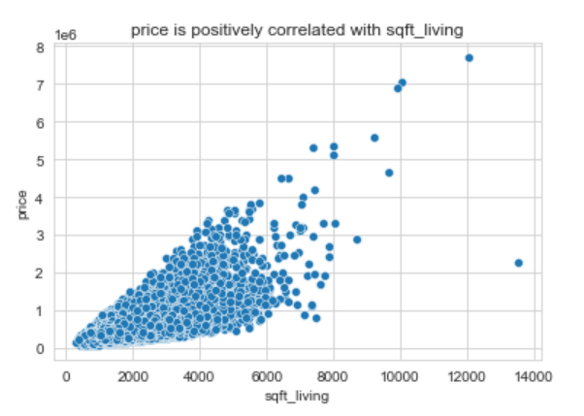
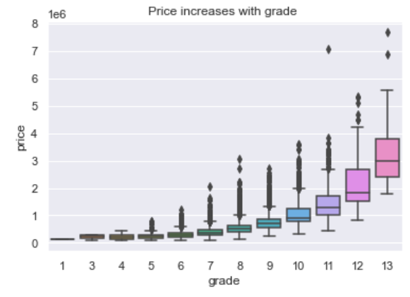
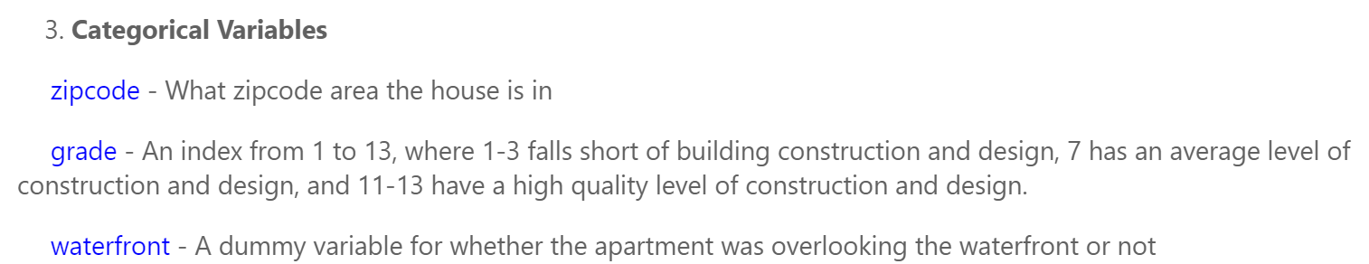
Data Preprocessing
21613 entries
Data cleaning
Feature
engineering
EDA
Column
Transformer
Notes:
This dataset has 20,000 observations, two kinds of variables. I have categorical variables: zip code and house quality grade, whether has waterfront; others are all numerical features, which contain the number of bedroom, bathroom, square footage of interior living space, basement, above, and the around public areas, also contain the environment qualifying features such as condition level, and how good the view is.

Slide 4
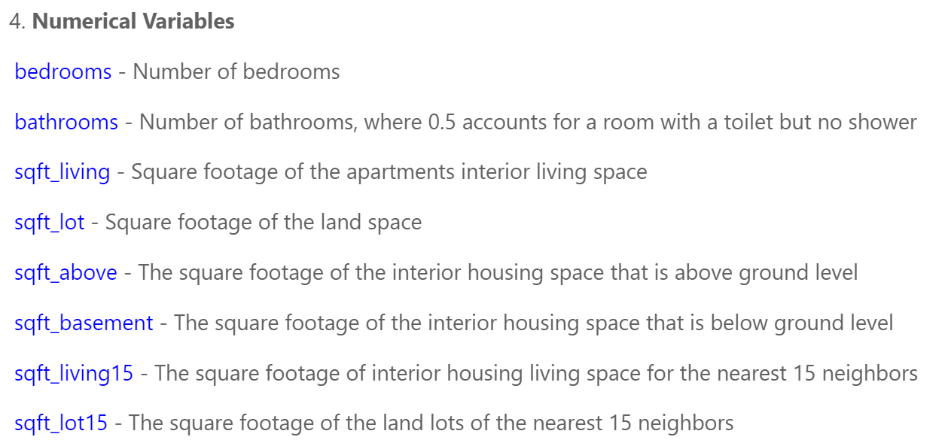
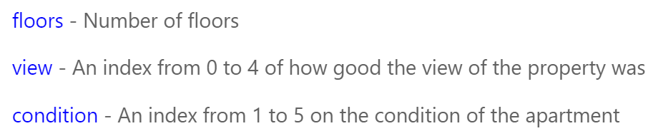
Data Preprocessing
Notes:
This dataset has 20,000 observations, two kinds of variables. I have categorical variables: zip code and house quality grade, whether has waterfront; others are all numerical features, which contain the number of bedroom, bathroom, square footage of interior living space, basement, above, and the around public areas, also contain the environment qualifying features such as condition level, and how good the view is.

Slide 5
Model Selection 5-fold cross validation
Model | R2
Ridge Regression | 80.69%
Random Forest regression | 81.69%
XGBoost Regression | 84.44%
Notes:
I trained 3 different regressors with 5- fold cross validation and picked XGBoost regression model as it has the highest R2.

Slide 6
Hyper-parameter tuning on XGBoost model
Best Score: 85.8%
Best Hyper-parameters:
Parameters | Description | Best value
gamma | Makes the algorithm conservative | 0
learning rate | shrinks the weights on each step | 0.3
max depth | control over-fitting | 5
min child weight | control over-fitting | 3
lambda | regularization | 2
Notes:
Gamma: Makes the algorithm conservative
Lr: Makes the model more robust by shrinking the weights on each step
Depth: Used to control over-fitting
Min child: Defines the minimum sum of weights of all observations Used to control over-fitting
Lambda: handle the regularization, is explored to reduce overfitting.

Slide 7
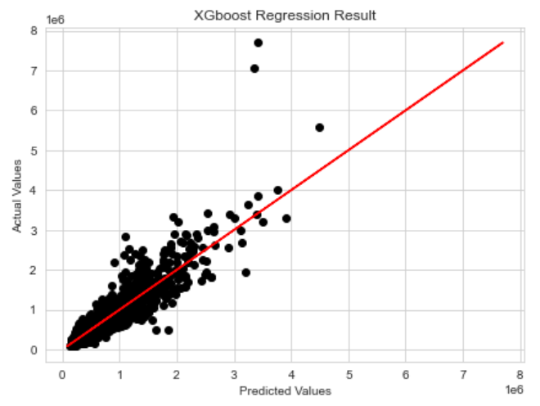
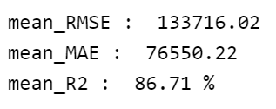
Model Evaluation on test data with 5-fold validation
Notes:
I trained the model with the best set of parameters and then fitted on the test data set. The scatter plot presents the relationship between actual prices and predicted prices. The right side show the evaluation metrics including rmse, mae and r2. here r2 is even larger than that on training data.

Slide 8
Model Interpretation
Error Analysis:
1. Check the highest prices
2. Conclusions：hidden factors
Feature Importance
Notes:
Then we can come to the error analysis. Based on the previous scatter plot, the model is not accurate especially when the actual price is very high.

Slide 9
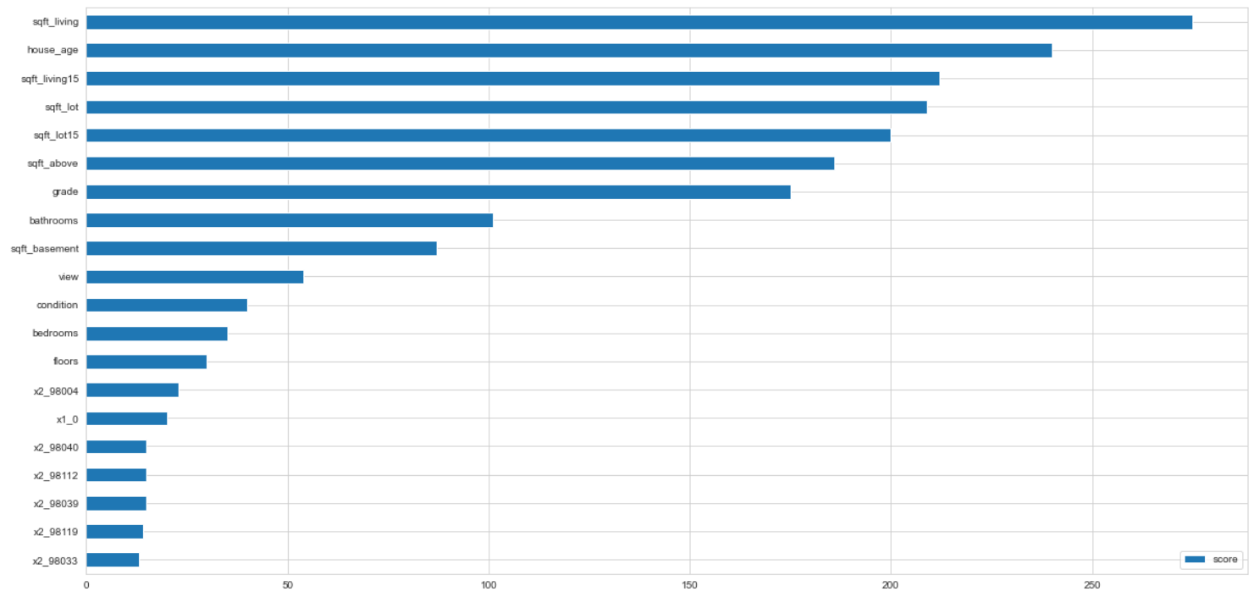
Feature Importance
Notes:
the land lots of the nearest 15 neighbors

Slide 10
Conclusion
Living square footage is most important feature
House age, grade, view, public area are also important
Feature spaces cannot predict high-end house prices
Fixing outliers and categorizing locations improves model performance

